Slide 1
AOER 101: An Introduction to Affordable and Open Educational Resources for Your Classroom
Dr. Megan Lowe
Director of University Libraries, Northwestern State University
This presentation is an adaptation of “OER 101” by Abbey Elder, licensed under a Creative Commons Attribution 4.0 International license.
Notes:
Introduction of self. Briefly mention experience and dissertation.

Slide 2
Fuller Attribution of Adaptation
This presentation is an adaptation of “OER 101” by Abbey Elder, licensed under a Creative Commons Attribution 4.0 International license, which itself is adapted from:
“Getting Started with Open Educational Resources” by Abbey Elder, licensed under a Creative Commons Attribution 4.0 International license
“OTN Training Slides” by David Ernst, available under a Creative Commons Attribution 4.0 International license,
“OER Basics” by Kelsey Smith, available under a Creative Commons Attribution 4.0 International license, and
“Finding and Evaluating OER” by Mahrya Burnett and Abbey Elder, also available under a Creative Commons Attribution 4.0 International license.
KPU Open Pedagogy Workshop by Arthur Gill Green and Jennifer Kirkey, available under a Creative Commons Attribution 4.0 license.
Using Web-Based Annotation to Enhance the Teaching & Study of Literature by Jennifer Gipson and Steel Wagstaff, available under a Creative Commons Attribution 4.0 license.

Slide 3
What are AOER?

Slide 4
A Definition for open educational resources (OER)
Open Educational Resources (OER) are learning, teaching and research materials in any format and medium that reside in the public domain or have been released under an open license, that permit no-cost access, re-use, re-purpose, adaptation and redistribution by others.
UNESCO
Notes:
Though the A comes first, we’re starting with the O – OER – because it’s easier to understand as a concept. OER are either public domain or have an open license, which grants users with certain permissions.
https://www.unesco.org/en/open-educational-resources

Slide 5
What kind of permissions?
Retain - make, own, and keep a copy
Revise - edit, adapt, and modify your copy
Remix - combine your copy with other existing material
Reuse - use your original, revised, or remixed resource
Redistribute - share copies with others
Notes:
Usually conferred through a CC license, like the one you saw on the opening slide of this presentation! If you haven’t watched the Copyright, Fair Use, and CCL presentation, be sure to check that one out! These permissions are sometimes called the 5R permissions.

Slide 6
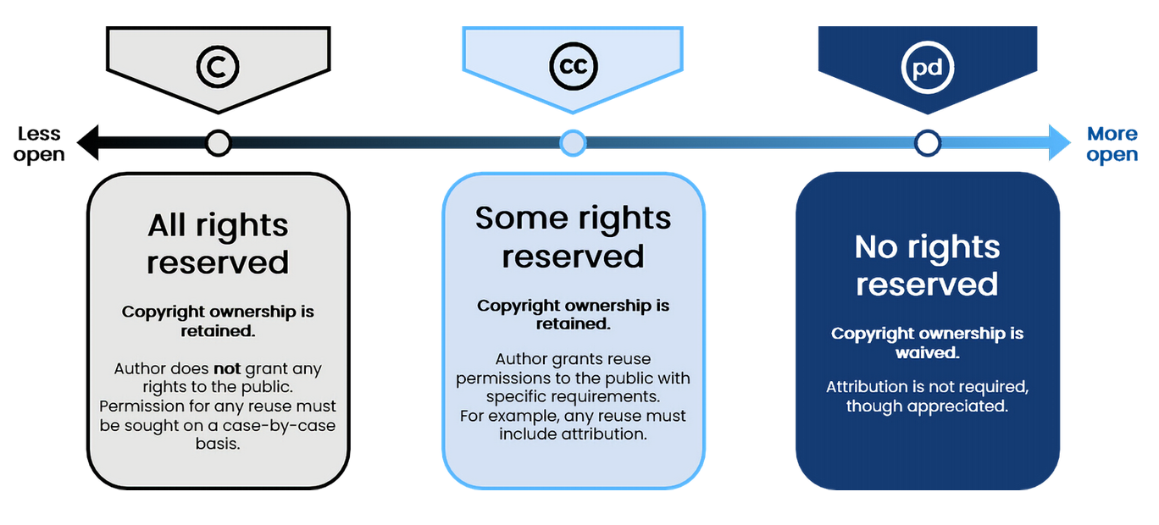
Licensing makes permissions clear
Image adapted by Abbey Elder from "Difference between open license, public domain and all rights reserved copyright" by Boyoung Chae, licensed CC BY 4.0
Notes:
I’m not going to linger on this slide – this is just a brief overview. Be sure to check out the Copyright, Fair Use, and CCL presentation!

Slide 7
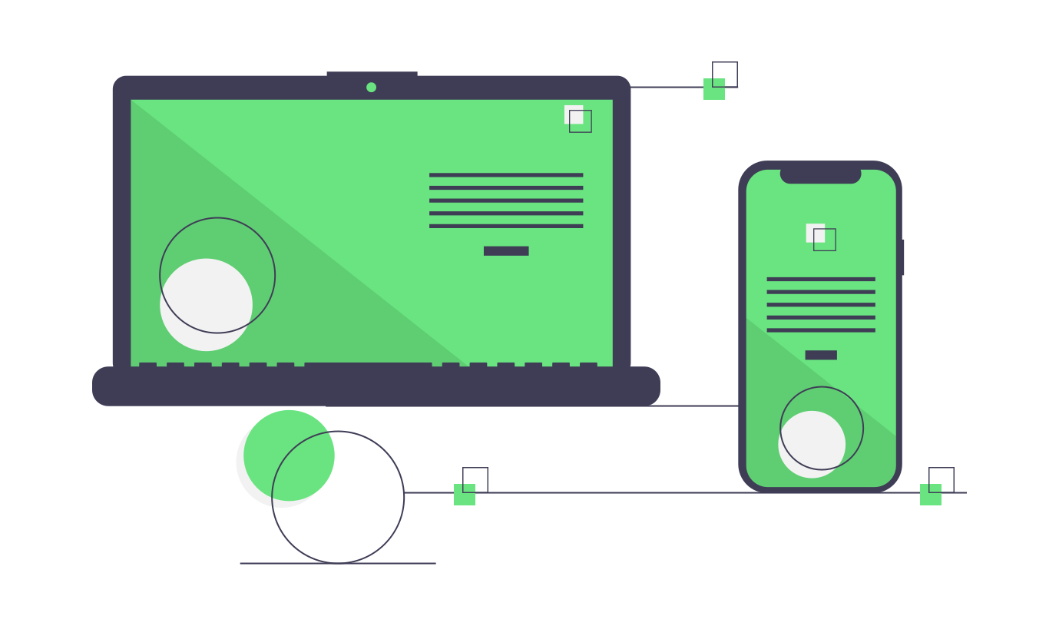
“OER” can be a lot of things, and that’s good!
Notes:
OER come in many types – OER can take all kinds of forms! One of the misconceptions I’ve encountered in talking with faculty about OER is that they think that open textbooks are the only kind of OER. Fortunately, that’s not true!
Icons from undraw.co, licensed CC BY 3.0.

Slide 8
Examples of non-textbook OER
Activities: H5P exercises and quizzes
Simulations: PhET Sims
Labs: Gel Electrophoresis Genetics Lab Sim
Videos: Class Piano Tutorials
Case Studies: Food Justice Primer
Homework Software: MyOpenMath
Lecture Slides & Lesson Plans: MIT Courseware

Slide 9
What isn’t OER?
Anything that isn’t BOTH free and open with 5R permissions:
Library-licensed resources: free (to you) but not open
Most blogs, podcasts, & websites: free but not (always) open
Images you find on Google: free but not open (check for a license!)
Open access monographs: free and open (may not be remixable)
If something isn’t an OER, that doesn’t mean you can’t use it!
Notes:
Some of these resource types may fall into the category of AER – AFFORDABLE education resources – which I’ll discuss shortly.

Slide 10
More on Affordable Education Resources (AER)
“A single or collection of required educational resources that may be offered at no or low cost to a student through a post-secondary education institution or an affiliated college bookstore at a pre-sales tax cost to a student that does not exceed an amount equal to four times the federal minimum wage” (LOUIS, 2021).
In Louisiana, an AER cannot cost more than $29, based on Act 125.
“AER includes copyright-protected material purchased by a library and provided to a student at no cost” (LOUIS, 2021).
These resources are traditionally copyrighted – when you use resources under the Fair Use statute, you are essentially using AER.
At the end of the day, SOMEONE has paid for an AER – either the institution or the student, but either way it helps the student obtain needed course materials while keeping costs for them down.

Slide 11
What are the pros and cons of AOER?
Notes:
It’s important to be honest about the limitations of such resources. While they definitely seem like a great idea – and they are – there are downsides.

Slide 12
Pros of AOER

Slide 13
Due to high textbook costs:
91% of students delayed purchasing required course materials.
70% of students tried to pass without purchasing required materials.
65% of students downloaded illegal copies of materials online.
34% of students had to purchase textbooks instead of groceries.
23% of students dropped a course, affecting their progress toward graduation.
ISU Student Survey, 2022
(Sample size of 1,913 students)
Notes:
These numbers don’t truly reflect the other realities of how expensive a college education is or how vulnerable college students can be. In the US, 30-40% of college students experience food insecurity. 40-50% of them experience housing insecurity. Students have had to choose between buying food and/or paying rent and purchasing course materials.

Slide 14
In addition to being free, OER can support:
Better learning outcomes
Higher retention rates
Closer alignment with your course objectives
More flexibility in how you teach
More up-to-date content
Notes:
The literature shows: students who don’t get access to the course materials early on, they don’t perform well academically. In the interest of full disclosure, inclusive access has its own problems, though it does increase first-day access to resources. That’s also one of the main benefits of AOER – they increase first-day access to resources. Without that access, though, students fall behind quickly. Their inability to participate fully in class increases the likelihood they’ll drop out. But when they have access to the materials in a timely fashion, they can participate equitably. When course materials don’t cost an arm and a leg, they can pay their rent – they can buy food. That also helps them perform well academically. This, in turn, increases their capacity for persistence.
But it’s not just about the students. Having more control over the course materials means you can more closely align the content with the objectives. AOER can provide you with more flexibility in how you teach – allowing you to engage with multiple modalities, for both your students’ benefit AND your own! It also allows you more freedom of expression in –how- you teach. AOER can help you customize/tailor your course materials!
In some disciplines, using AOER allows you to use more up-to-date content, rather than waiting between editions as one might for a traditional commercial textbook. The best example I have of this is an atmospheric sciences professor who preferred using real-time NOAA maps in class to teach.

Slide 15
How?
Access. All students can access OER used in their courses, not just those with the means to purchase.
Fit. Open content can be adapted to better fit the teaching style and learning objectives of your course. Multiple modalities!
Relevance. OER can be revised as needed, not on a publisher’s timeframe (which may be more or less often than you’d like).
Accessibility. OER can be adapted to meet accessibility standards if it doesn’t already.
Notes:
Adapted from OER Basics by Kelsey Smith, licensed CC BY 4.0.
Access also means considering the DEI piece of what we do in higher education. We are able to support equitable access to resources, to be more inclusive.

Slide 16
How is this good for colleges?
Providing free course materials can help current students continue in their degree path, take more courses, and progress to graduation.
Showcasing OER created at or adapted for use at an institution can help build interest in your school’s curriculum among potential future students and parents.
It can also showcase the capacity and expertise of your institution’s faculty in both content and pedagogy.
Notes:
It supports retention and persistence! It increases affordability, making a college education more accessible. Building curricula! But also – these types of pursuits are gaining more and more validity as tenure/promotion activities.

Slide 17
How is this good for authors?
Unlike commercial publishing, OER authors retain copyright over their work.
Going open widens the reach of a work to a global audience, for greater impact. This helps showcase an author’s expertise as an instructor and an expert in their field.
The adaptation and production of OER, and/or innovation in the classroom thanks to OER, can be leveraged in tenure & promotion discussions (oept.pubpub.org).
Notes:
Since most OER use open licenses, authors retrain control of their work.

Slide 18
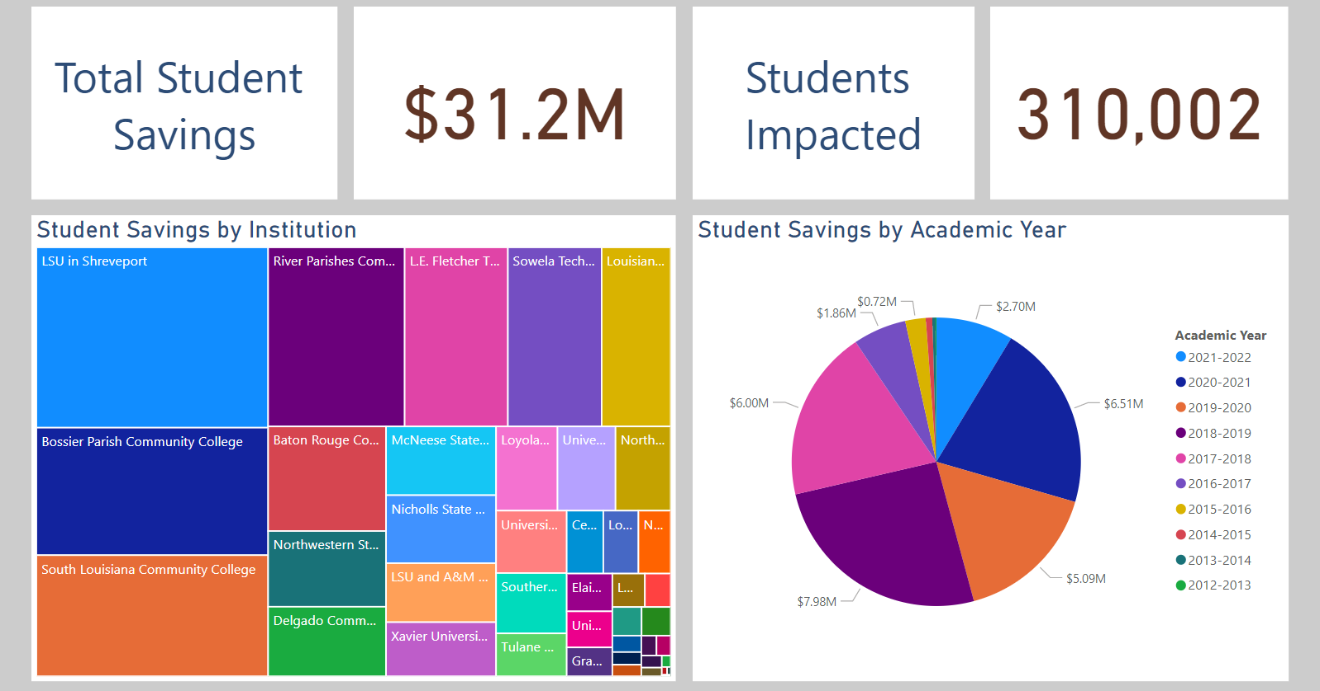
Impact in Louisiana of OER Use
Notes:
Joining a community of practitioners across the state!

Slide 19
Cons of OER

Slide 20
Because OER are a relatively recent innovation…
There may be variable availability of OER in:
Your discipline
The level(s) you teach
The format(s) you prefer

Slide 21
Most of these issues are not inherent to OER or only found in these materials.

Slide 22
The biggest barrier to adopting OER:
NOT content
NOT accessibility
NOT quality, but…
TIME

Slide 23
Wrapping Up

Slide 24
You have options
This is not an “all or nothing” conversation.
You can adopt some OER without jumping in completely!
Start small and innovate!

Slide 25
Take stock of what you have
Materials you’ve created
AOER currently available
Sources of support (staff, time, and/or funding)

Slide 26
Figure out what you need
Materials you can create
Gaps in the available OER (what else can you use? What AER may be available?)
Support available externally (disciplinary working groups, state grants, etc.)

Slide 27
AOER represent opportunities.
You can adopt, adapt, or create content for your course.
You can fully integrate OER or adopt only ancillaries.
Use the resources at your disposal--and be creative!
AER are a valid option as well – what does your library provide access to that could be leveraged?
You don’t have to do this alone!

Slide 28
Have questions? Reach out!
Contact me at loweme@nsula.edu

