Slide 1
Finding and Evaluating AOER: Identifying Sources of and Support for AOER
Dr. Megan Lowe
Director of University Libraries, Northwestern State University
This presentation is an adaptation of “OER 101” by Abbey Elder, licensed under a Creative Commons Attribution 4.0 International license.
Notes:
Adaptation of “OER 101” by Abbey Elder, licensed under a Creative Commons Attribution 4.0 International license, which itself is adapted from:
“Getting Started with Open Educational Resources” by Abbey Elder, licensed under a Creative Commons Attribution 4.0 International license
“OTN Training Slides” by David Ernst, available under a Creative Commons Attribution 4.0 International license,
“OER Basics” by Kelsey Smith, available under a Creative Commons Attribution 4.0 International license, and
“Finding and Evaluating OER” by Mahrya Burnett and Abbey Elder, also available under a Creative Commons Attribution 4.0 International license.
KPU Open Pedagogy Workshop by Arthur Gill Green and Jennifer Kirkey, available under a Creative Commons Attribution 4.0 license.
Using Web-Based Annotation to Enhance the Teaching & Study of Literature by Jennifer Gipson and Steel Wagstaff, available under a Creative Commons Attribution 4.0 license.

Slide 2
Fuller Attribution of Adaptation
This presentation is an adaptation of “OER 101” by Abbey Elder, licensed under a Creative Commons Attribution 4.0 International license, which itself is adapted from:
“Getting Started with Open Educational Resources” by Abbey Elder, licensed under a Creative Commons Attribution 4.0 International license
“OTN Training Slides” by David Ernst, available under a Creative Commons Attribution 4.0 International license,
“OER Basics” by Kelsey Smith, available under a Creative Commons Attribution 4.0 International license, and
“Finding and Evaluating OER” by Mahrya Burnett and Abbey Elder, also available under a Creative Commons Attribution 4.0 International license.
KPU Open Pedagogy Workshop by Arthur Gill Green and Jennifer Kirkey, available under a Creative Commons Attribution 4.0 license.
Using Web-Based Annotation to Enhance the Teaching & Study of Literature by Jennifer Gipson and Steel Wagstaff, available under a Creative Commons Attribution 4.0 license.

Slide 3
How do you find AOER?

Slide 4
The Realities of Searching
One of the earliest complaints about OER was that there simply weren’t that many available.
While that complaint still holds water in some corners – certain disciplines, certain education levels – in other corners, that is most certainly no longer the case.
Our old friend Google is good at many things, but it’s not always great at helping discover OER.
Between all of these points, discovering OER can be difficult and overwhelming. There’s so much out there that it can be hard to know where to start!
Additionally, regarding AER, since those are often located in databases or online catalogs, they are not freely available on the web.

Slide 5
Making the Search Process Effective
Identify keywords (e.g., discipline, level, type of resource wanted/needed).
Search broadly (Affordable Learning LOUIS, OASIS, Open Textbook Library, OpenStax, even Google/Google Scholar).
Start general and then get specific – filter results using different parameters.
Take advantage of curated lists (working smarter not harder).
Curate content (evaluate: relevancy, accuracy, quality, accessibility, licensing).
Reflect and repeat (did you find materials that fit your needs?).
Notes:
Additional OER repositories and databases can be found at https://instr.iastate.libguides.com/oer

Slide 6
OER Treasure Hunt Worksheet
The Treasure Hunt Worksheet can be a useful tool for guiding your OER Search process. The worksheet gathers information such as:
Course Identification
Topic identification
Search
Curation
Reflect
The worksheet is licensed under CC BY attribution! Feel free to modify.
This work by Abbey Elder is licensed under a Creative Commons Attribution 4.0 International License. It is an adaptation of SPARC’s adaptation of “OER Treasure Hunt Worksheet” by Mathieu Plourde available at www.udel.edu/003275 also under a Creative Commons Attribution 4.0 International License.

Slide 7
Benefits of Searching OER Repositories
Searching an OER repository can result in a faster and more productive search.
Resources have been curated and organized into various categories including discipline, format, and open license.
Many repositories have either peer reviews or a rating scale where users have shared their perception or experience with the resource.
As always: there’s no need to reinvent the wheel.

Slide 8
Search Tips
Access different repositories and continue checking because they are always growing and being updated. Be sure to use their filters to refine (e.g., date, material type, etc.).
Switch up your search terms (use synonyms and broader, or narrow terms).
Use Boolean Operators (AND, OR, NOT) to boost the power of your search.
Look for smaller pieces of content or weekly topics (chapters, ancillary materials, etc.).
Keep a record of your results.
Know when to stop searching.
Sometimes the perfect OER just doesn’t exist. You may need to think about adapting/creating an OER, selecting an Affordable Educational Resource, or using a library resource.

Slide 9
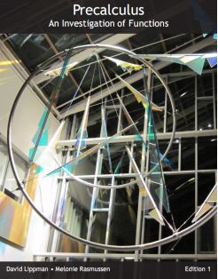
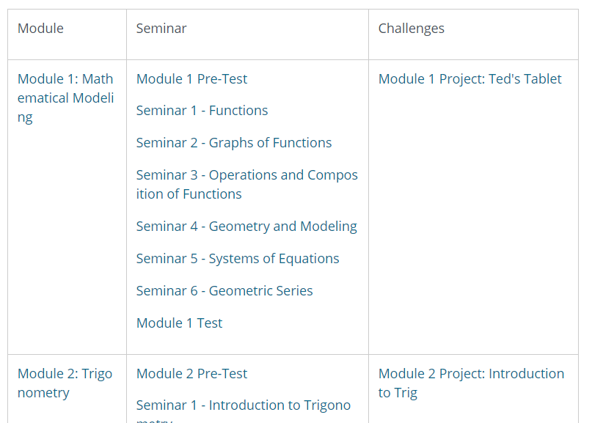
You may find a lot...

Slide 10
Or not so much.
…or not so much.
The oldest title on this list is from 2012. The newest title is from 2019.
In some disciplines, currency may not matter. In others, it most certainly will.

Slide 11
You may find next to nothing.

Slide 12
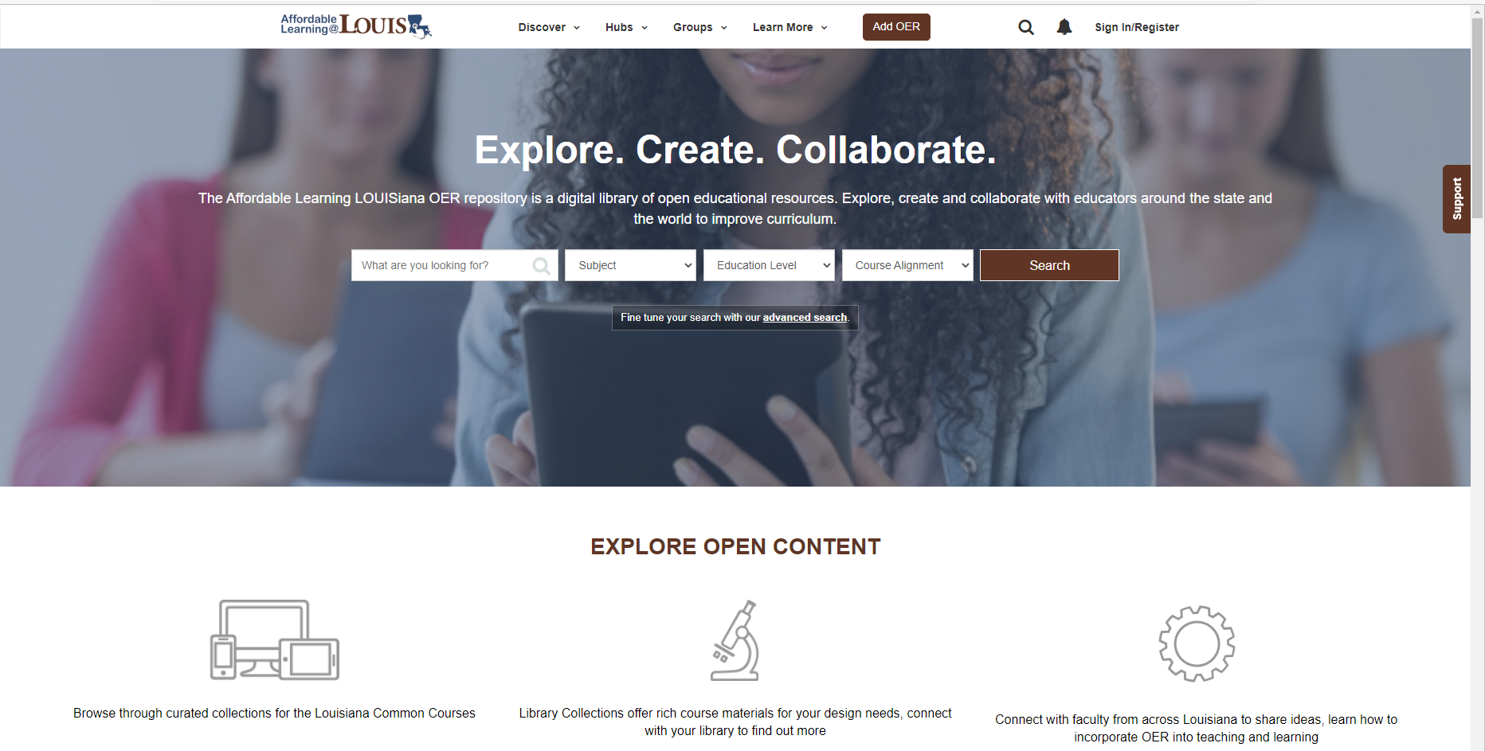
Search: Affordable Learning LOUISiana Collections
Benefits of using LOUIS OER Commons:
Open resources are aligned with the Louisiana Statewide common course catalog.
LOUIS OER Commons facilitates the creation of OER by Louisiana educators.

Slide 13
How do you evaluate OER?

Slide 14
Evaluation may be based on...
Rubrics
Review Processes
Your individual needs

Slide 15
Rubrics Available
Comprehensiveness
Content Accuracy
Relevance/Longevity
Clarity
Consistency
Modularity
Organization/Structure/Flow
Interface
Grammatical Errors
Cultural Relevance
Open Textbook Library Rubric (pictured right)
BCCampus Rubric [PDF]
Open Oregon Faculty Checklist for Evaluating Course Materials (not just OER)

Slide 16
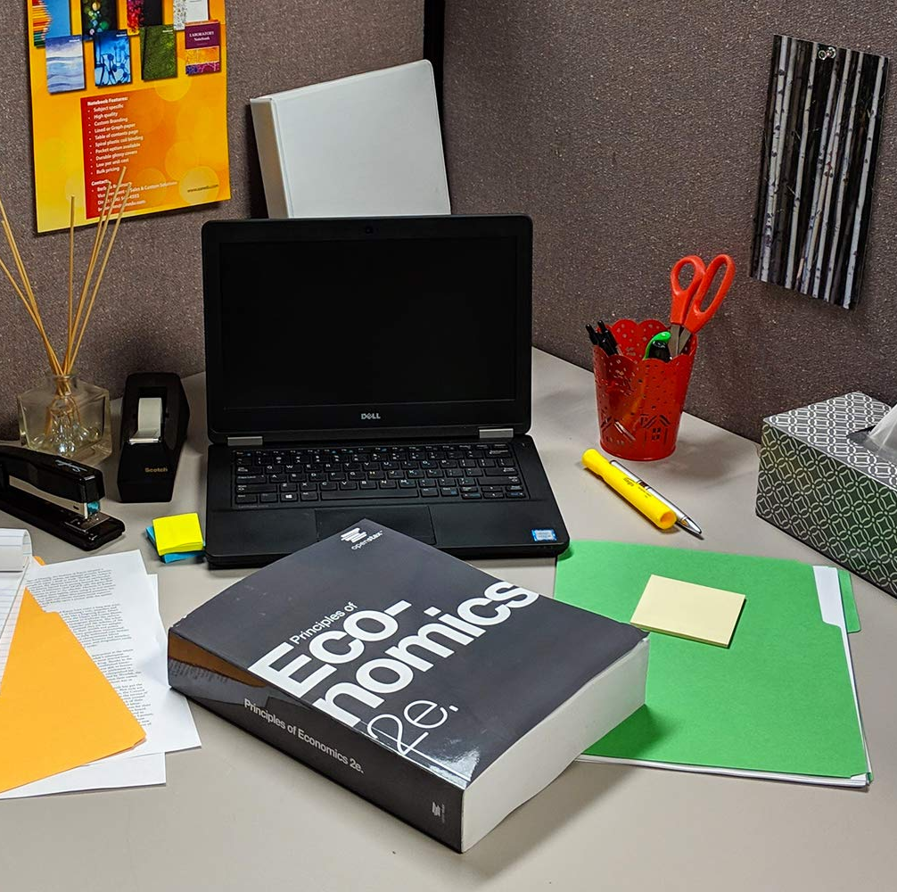
The Basics
Content coverage
Alignment with your course
Accessibility
Inclusivity
Format(s) available

Slide 17
Other Review Processes
Unlike commercial textbooks, many open textbooks undergo peer review by subject matter experts.
Other reviews may include:
User reviews posted in repositories like the Open Textbook Library
Reviews by organizations (e.g., American Institute of Mathematics)
Notes:
Check for peer review attribution in the Front Matter or Back Matter of a book for more information.

Slide 18
Going back to Affordable Learning LOUISiana…. …and LOUIS…

Slide 19
If you aren’t familiar with LOUIS…
It is the statewide academic library consortium, featuring 48 member institutions/libraries representing 2-year and 4-year, public and private, and special institutions.
Begun in the late 1990s at LSU, LOUIS is now under the auspices of the Board of Regents.
All institutions within the UL System are members of LOUIS.
Through LOUIS, libraries acquire resources in more cost-effective ways through cooperative procurement. It also supports professionals working in libraries throughout the state through professional development.
LOUIS also coordinates many affordable learning programs in the state through Affordable Learning LOUISiana.

Slide 20
Most of the electronic databases and resources accessible through your libraries are acquired through LOUIS. These resources include a variety of periodicals/journals, ebooks, and other resources. Consequently, you have access to all kinds of Affordable Education Resources (AER) through LOUIS.

Slide 21
This list is for Northwestern, but it’s representative of what all LOUIS libraries have access to. All of these resources represent potential AER.

Slide 22
LOUIS is also involved in AOER efforts!
LOUIS coordinates a lot of AOER efforts in the state!

Slide 23
Two More Tools You Can Use (thanks to LOUIS)!

Slide 24
CloudSource OA
You don’t have to do anything to take advantage of CloudSource OA. It’s already integrated into your libraries’ systems. This is what it looks like for University Libraries at Northwestern State University.

Slide 25
CloudSource OA
You don’t have to do anything to take advantage of CloudSource OA. It’s already integrated into your libraries’ systems. This is what it looks like for University Libraries at Northwestern State University.

Slide 26
BLUEcloud Course Lists Bookmarklet
Course Lists takes more effort. It’s a plugin that works with most learning management systems (including Moodle and Canvas). You already have access to this resource – just takes making sure the plugin is enabled on the back end.

Slide 27
Course Lists hasn’t been fully integrated into Canvas yet, but we wanted to make y’all aware that it will be coming soon! Look out for programming later in the year!

Slide 28
Resources
Getting started: https://cuny.manifoldapp.org/projects/the-oer-starter-kit-workbook
Treasure Hunt Worksheet: https://uhlibraries.pressbooks.pub/oerhandbook/chapter/activity-oer-treasure-hunt-worksheet/
Tips for searching: https://instr.iastate.libguides.com/oer/search
LOUIS and ALL: https://louislibraries.org/alearningla/programs
LOUIS OER Commons: https://louis.oercommons.org/

Slide 29
Resources
Open Textbook Library Rubric: https://open.umn.edu/opentextbooks/reviews/rubric
BCCampus Rubric: https://open.bccampus.ca/files/2014/07/OERR-Rubric.pdf
Open Oregon Faculty Checklist for Evaluating Course Materials (not just OER): https://docs.google.com/document/d/1J0oT1xZCciyXtk1I7MB_r9saVDHlpQD7Ml5Ep9uCLfM/edit

Slide 30
Have questions? Reach out!
Contact me at loweme@nsula.edu

