Slide 1
Trauma Informed Classroom Instruction
Adopted from presentations by
Dr. Mary Renda and Dr. Aimee Hollander

Slide 2
Your Presenters
Elizabeth Blankenship (University of New Orleans)
Meredith King (University of New Orleans)

Slide 3
Today’s presentation
Where Y'at?!
What is trauma-informed classroom instruction
Principles and examples
Grounding and settling practices for us and our students
Do’s and don’ts of engaging with others during a trauma response

Slide 4
Where Y’at?!
Grounding exercise
How is everyone doing?

Slide 5
What is trauma-informed classroom instruction?
Trauma is not an event itself, but the body's protective response to an event or series of events that is experienced as harmful or life-threatening.
It can have lasting emotional and physical effects on an individual. Importantly, trauma is not experienced the same by everyone.
A traumatic event for one individual may or may not prompt a trauma response in another, even if the experiences seem similar.
Everyone's response is unique and independent of those around them.

Slide 6
What is trauma-informed classroom instruction?
Trauma-informed pedagogy is pedagogical practice that keeps trauma, its prevalence, and how it affects an individual, in mind. These include practices such as:
Providing content information in advance
Using content descriptions, especially for potentially triggering media
Creating a safe and inclusive framework for discussions
Checking in on students
Encouraging community building and sense of belonging
Allowing for multiple ways to engage with course content
Building flexibility into assessment and absence policies
Valuing student input and feedback

Slide 7
Principles and Examples Discussed Today
Predictability and Transparency
Connection and Community
Flexibility and Multiple Alternatives
Belonging and Inclusion
Empowerment and Co-Creation

Slide 8
PREDICTABILITY AND TRANSPARENCY: Predictability and transparency can create a sense of safety for students who have experienced trauma and feel a loss of control over what could happen to them.
Provide information about content in advance of class meetings (course schedule or syllabus with topics).
Use content descriptions and warnings for readings that are potentially triggering.
State what content and interactive elements will be included at the start of a class session.
Use a routine or consistent structure for how classes are facilitated.
If introducing a new facilitation or participation structure, give detailed instructions, expectations, and an example of how the structure will work.
Use rubrics to clearly state instructor expectations for assignments, participation, etc.
Provide concrete options for how students can “take care of themselves” if they feel triggered by a topic or conversations (mute your video, send me a private chat, take a break, do a breathing exercise, get a drink of water, take a walk outside, etc.).

Slide 9
Connection and Community
Building community is important for increasing students’ capacity for social engagement after trauma causes feelings of disconnection and isolation.
Examples
Explicitly talk about the importance of community building, learning from each other, and supporting each other within your class.
Begin class with asking students about how they are doing, how their week has been going, or with a temperature check about their mood (discussion question, anonymous poll, etc.).
Approach questions or concerns from a class/community perspective
For example - How do we as a class want to address this? What does this mean for us as a community? How can we all support each other through this?
Encourage students to build connections with each other through forming study groups, sharing support resources, and checking in on each other.

Slide 10
Flexibility and Multiple Alternatives
An individual’s body can respond in unpredictable ways to keep them safe during a trauma response.
Instructors need to be flexible to meet students’ needs in order to resist re-traumatization.
Examples
Provide options for different ways of engaging with material, especially if a topic may be triggering.
For example, offer students the option of choose between different breakout groups that will focus on a specific aspect of the topic – different perspectives of a topic
Provide options for different ways of engaging with material, especially if a topic may be triggering.
For example, for a class topic on childhood abuse, you can provide students with the option of doing a written assignment on a variety of related topics
Provide various ways to engage in the topic – quizzes, short answer, different type of assignments that meet the objective

Slide 11
Flexibility and Multiple Alternatives Cont.
Provide options for projects or assignments on topics that may be triggering
Rather than only providing one topic for an essay assignment, provide options for several topics so that students can choose a topic that feels most feasible for them to address without experiencing re-traumatization.
Offer a certain amount of quizzes or assignments that can be dropped and offer a certain amount of days that students can be absent without needing a justification.
Encourage students to contact you about accommodations and give some examples of accommodations you feel comfortable offering.

Slide 12
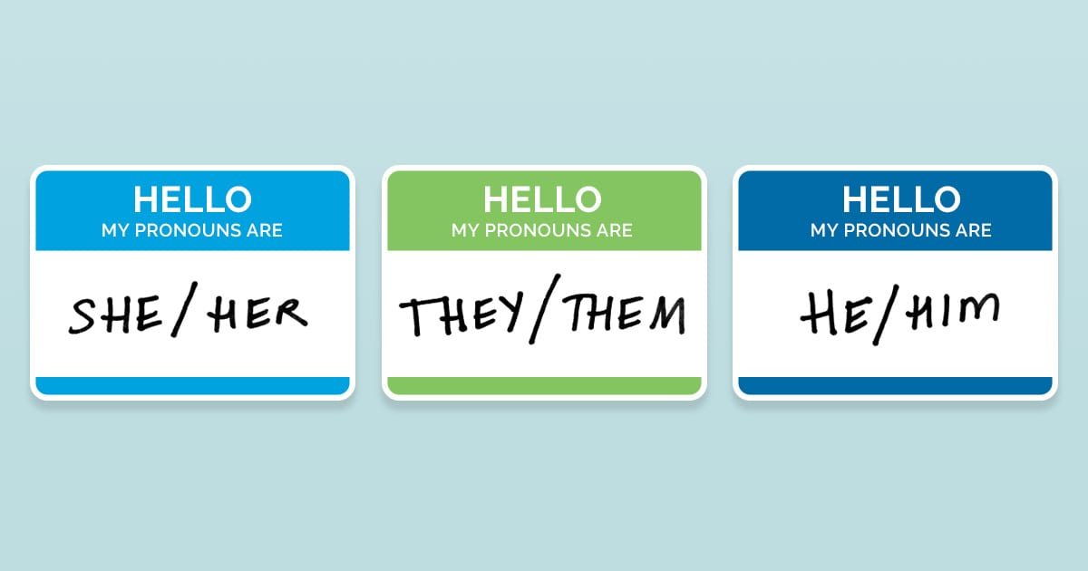
Belonging and Inclusion
Intentionally cultivating a classroom where students feel included can lower the students’ perceptions of danger and increase capacity for engagement and learning.
Examples
Use students’ properly pronounced names and pronouns (this can be entered in zoom by clicking re-name by your name).
Explicitly acknowledge your intention to create an inclusive classroom environment and include a class agreement that acknowledges oppression.

Slide 13
Belonging and Inclusion Cont.
Assume your students have been affected by the topics that come up during class. Resist making statements that would make a student feel alienated for their experience.
For example, if you are talking about the rate of attempted suicide in the United States, assume that someone within your class has attempted suicide and do not make generalized statements like “People who attempt suicide have fewer social support systems.”
Challenge statements or generalizations that could be harmful to students.
Talk about mistakes as an essential part of the learning process and challenges as being necessary for success.
Acknowledge any mistakes you might make as an instructor, stress your commitment to taking your students’ concerns seriously, and explain your concrete steps to create an environment that intentionally includes and values them.
Recognize how equity issues are woven into the experience of trauma: when a person from a marginalized group experiences trauma, the same conditions that marginalize them may limit their access to resources (Venet).

Slide 14
Empowerment and Co-Creation
When experiencing trauma, individuals often lose the ability to make decisions to protect themselves.
By valuing students as co-creators in the classroom, instructors can contribute to students building trust in their abilities, knowledge, and contributions.
Examples
Explicitly state the value of students’ knowledge, insights, and expertise within the course.
Ask students about their preferences around topics, participation, and assignments through an individual form and/or through a class discussion.
Encourage students to notice what they need in order to take care of themselves and be successful in their learning, express their needs, and meet their needs.
Ask students about their knowledge of a topic before introducing it so that they can share their insights about what they already know.
Provide frequent opportunities for student feedback about how the class is going and students’ experiences with the material and the course structure (mid-term survey)

Slide 15
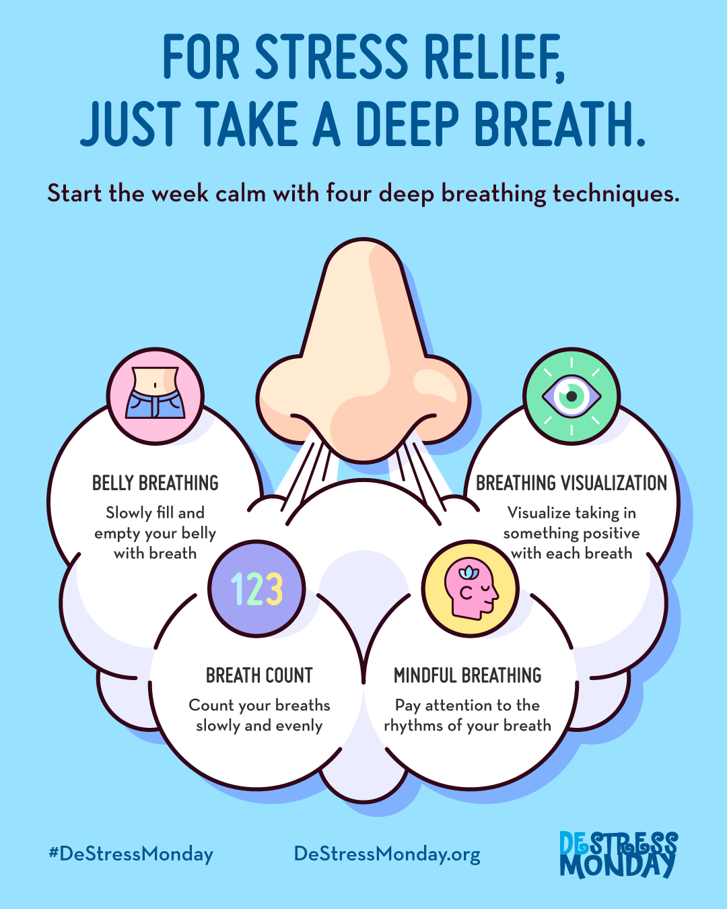
Grounding / Settling Practices: BREATHING
Box breath - trace a box in your mind as you inhale to a count of 4, exhale to a count of 4, inhale to a count of 4, and then exhale to a count of 4
Inhale and exhale as you trace the outline of your fingers, inhale while moving up a finger, exhale while moving down
Breathe in and out of your belly

Slide 16
Grounding/Settling Practices: VOCAL PRACTICES
Hum in a low tone
Buzz like a bee, experimenting with different tones
Sing or hum a song

Slide 17
Grounding/Settling Practices: IMAGINATION AND MOVEMENT
Think about a time when you felt loved/happy. Notice what happens in your body
Think about a place in nature that you like to be. Recall it into mind with your 5 senses.
Move around your space.
Tense and relax a part of your body.
Stretch your arms, then your legs.

Slide 18
Do’s: Things to do in the moment
Demonstrate and communicate calmness
Listen nonjudgmentally
Empathize with how the person feels about their experiences
Be patient, allow plenty of time
Offer reflective comments about what they are saying
Provide different options rather than offering one choice
Communicate your presence and support
Ask consent before providing resources
Sample language:
○ Thank you so much for sharing that with me.
○ Please do whatever is good for you right now, I’ll just be here.
○ That must be frustrating.
○ It makes sense for you to have that reaction.
○ I appreciate you being willing to share that.
○ Would you like to turn off the video and mute yourself for a little or would you like to stay connected?

Slide 19
Don’ts: Things not to do in the moment
Make
Make decisions that remove their control
Rush
Rush to make assessments or give them resources
Use
Use shame or threats
Use
Use patronizing statements
Touch
Touch someone
Act
Act alarmed, horrified, embarrassed
Use
Use sarcasm

Slide 20
Afterwards
Check in with yourself and what you need to do in order to settle yourself and address any of the tension or emotions you might be feeling

